Slide 1

AGILE THERAPEUTIC SYSTEMIZATION
Under the guidance of
Smt.Ch.SugunaLatha[M.Tech]
Assistant Professor
Submitted by:
B.MeghaChandana(15481A1218)
A.Anusha(15481A1210)
K.S.S.Pavani(15481A1252)
A.V.Gowtham(15481A1212)

Slide 2
CONTENTS
Abstract
Introduction
Objectives of project
Outcomes of the project
Existing system
Proposed system
System Requirements
Literature review
Data collection
Design /Methodology
Implementation and Testing

Slide 3
Abstract
Now-a-days we have many problems in finding the website which gives precise information regarding health care. It is hard to find the proper medication of diseases and their cost related information in a single domain. Even getting appointments from the doctors became a hectic task. According to W.H.O (World Health Organization) survey, every year 1,40,000 people die in situations that could have been prevented. Many deaths could be prevented if first-aid is given before emergency services arrive.
So, Agile Therapeutic Systemization is aimed to design an interface which connects patients and doctors together in a single platform. Through this website one can access and gain understanding on remedial of diseases. In proposed system, the prime objective is to create a full-fledged web application which could give clear information of diseases and the price of medicines. The user can register and find the information related to diseases. Also user can make doctor’s appointment easily. By watching emergency tutorial videos, the user can rescue in a serious situation. From this project, we hope to decrease the death rate to some extent.

Slide 4
Introduction
Agile therapeutic systemization is the fastest and easiest way of healing diseases in a systemized format.
To positively influence the health and behaviour of individuals.
But most of the people are not aware of health education.
Many deaths could have been prevented if first aid is given before the emergency services arrive.

Slide 5
Objectives
To develop a consistent healthcare website.
To decrease death rate to some extent.
To reduce human effort.

Slide 6
Outcomes
To know about adverse diseases, its effects and prevention.
To make doctors appointments easily.
To rescue from a critical situation.

Slide 7
Existing system
We have many websites which contains either disease information or treatment information.
We can also find online appointment websites.
No system constitutes all the modules in a single domain.

Slide 8
Disadvantages
Difficult to get an appointment from doctors.
More complexity in searching information.
Negligence and not having enough time.
Consumes lot of time.
Lack of basic awareness of medicine prices.

Slide 9
Proposed system
User can find the information related to diseases.
User can make online doctor appointment.
Prices of medicines.
Emergency tutorial videos.

Slide 10
Advantages
Complete information in a single domain.
Increase of awareness among users.
Time saving system.
Prevention of diseases.
Treatment information.
Reduces fear among patients.

Slide 11
System requirements
Hardware requirements:
Processor: Pentium IV or above
RAM :1GB or above
Hard disk:500GB or above
Software requirements:
Operating system: windows 7
Front-end: HTML, JS,CSS.
Back-end: PHP.
Database: MYSQL.

Slide 12
Literature review
Multi criteria decision making in health care by Melanie by Reuter- Oppermann
The development and use of new models and concepts to support decision making in health care has constantly increased over the last decades and a variety of techniques has been applied

Slide 13
Integrated scheduling of tasks and gynaecologists to improve patient appointment scheduling by S.T. Luen-English.
Despite the time invested in creating the schedule, the compliance of the achieved schedules with the preferences of gynaecologists is low, and the number of scheduled outpatient clinic hours is unbalanced over the weeks.

Slide 14
Data collection

Slide 15
User login
In this module user can gain access to the website by signing into his account.
If he wants to made appointment or use any of the information, he must surely sign in into his account. Terms and conditions applied.

Slide 16
Hospital login
The hospital management checks the no of patients made appointments.
They can also view the information regarding diseases and videos.

Slide 17
Disease info
This module includes the general disease information which we mostly observe in our surroundings.
Also the list of medicines required to cure the diseases.
And prices of the medicines

Slide 18
Appointment
If the patient wants to make an appointment, he must fill the required details in the appointment section and have to submit the details.

Slide 19
Videos
This includes the general first aid videos through which one can rescue from danger.

Slide 20
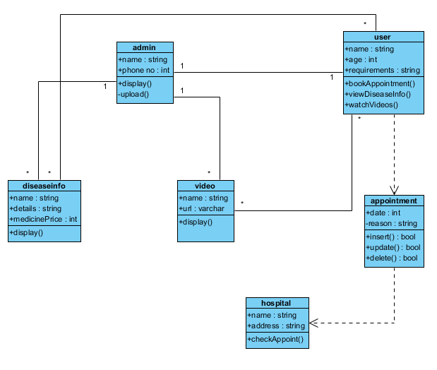
Class diagram:

Slide 21
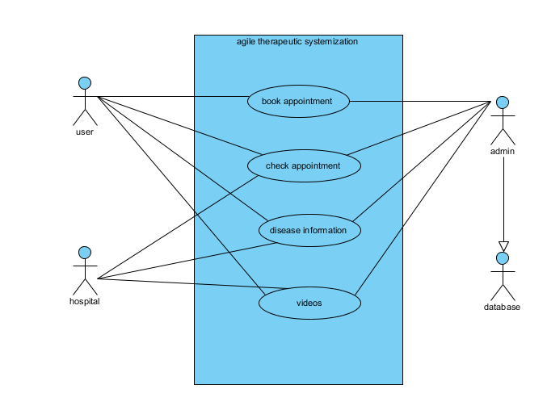
Use case diagram:

Slide 22
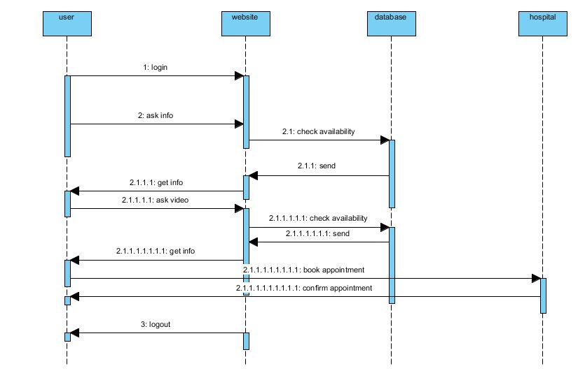
Sequence diagram

Slide 23
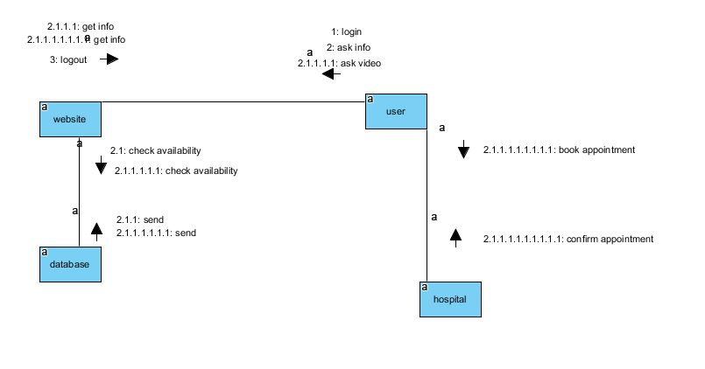
Collaboration diagram

Slide 24
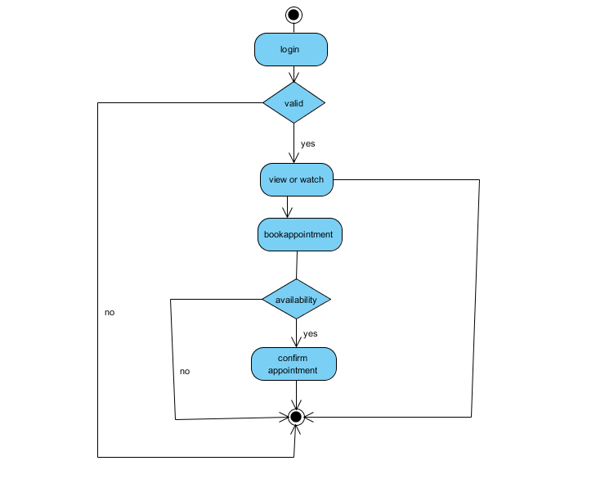
Activity diagram

Slide 25
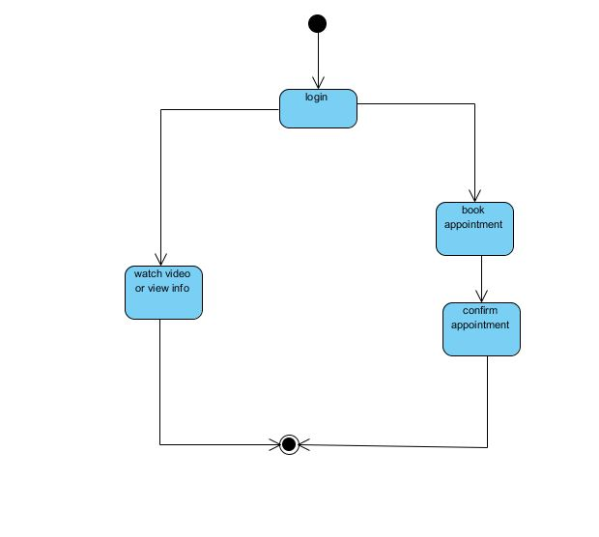
State chart diagram

Slide 26
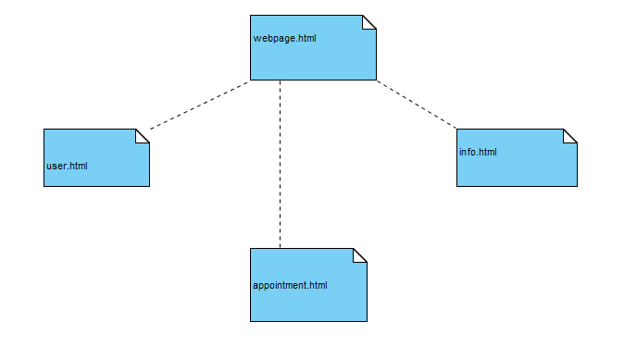
Component diagram

Slide 27
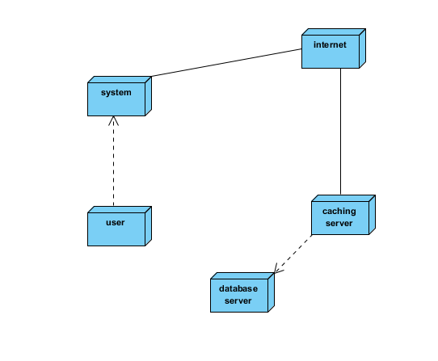
Deployment diagram

Slide 28
Implementation and Testing

Slide 29
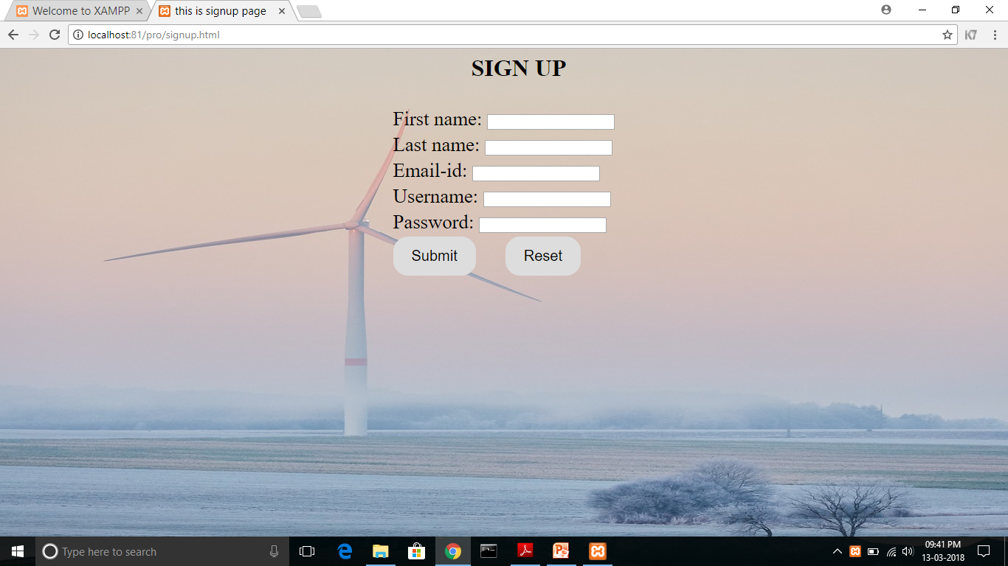
Displaying the registration page of Agile Therapeutic Systemization

Slide 30
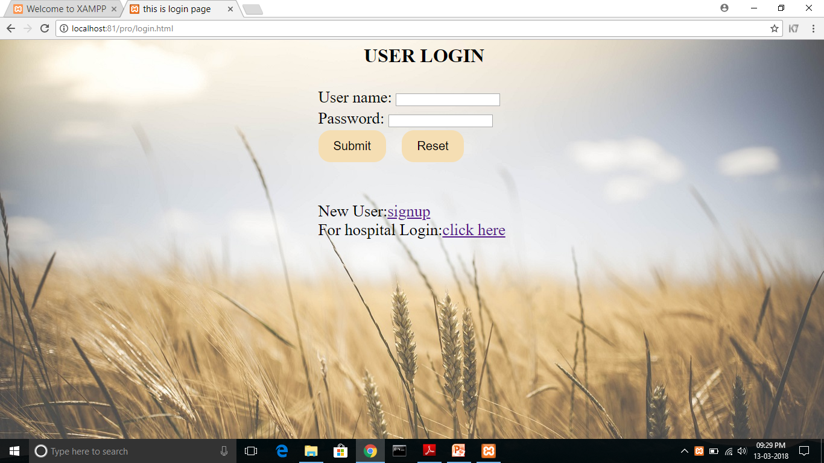
Displaying the Login page

Slide 31
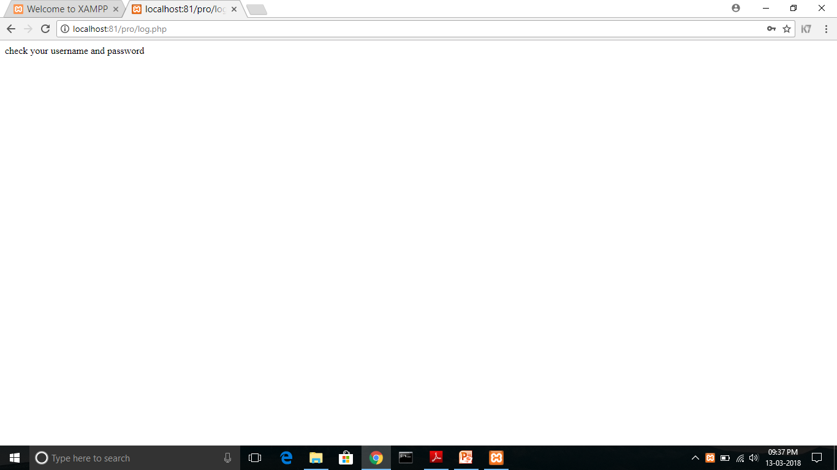
If the user enters invalid information

Slide 32
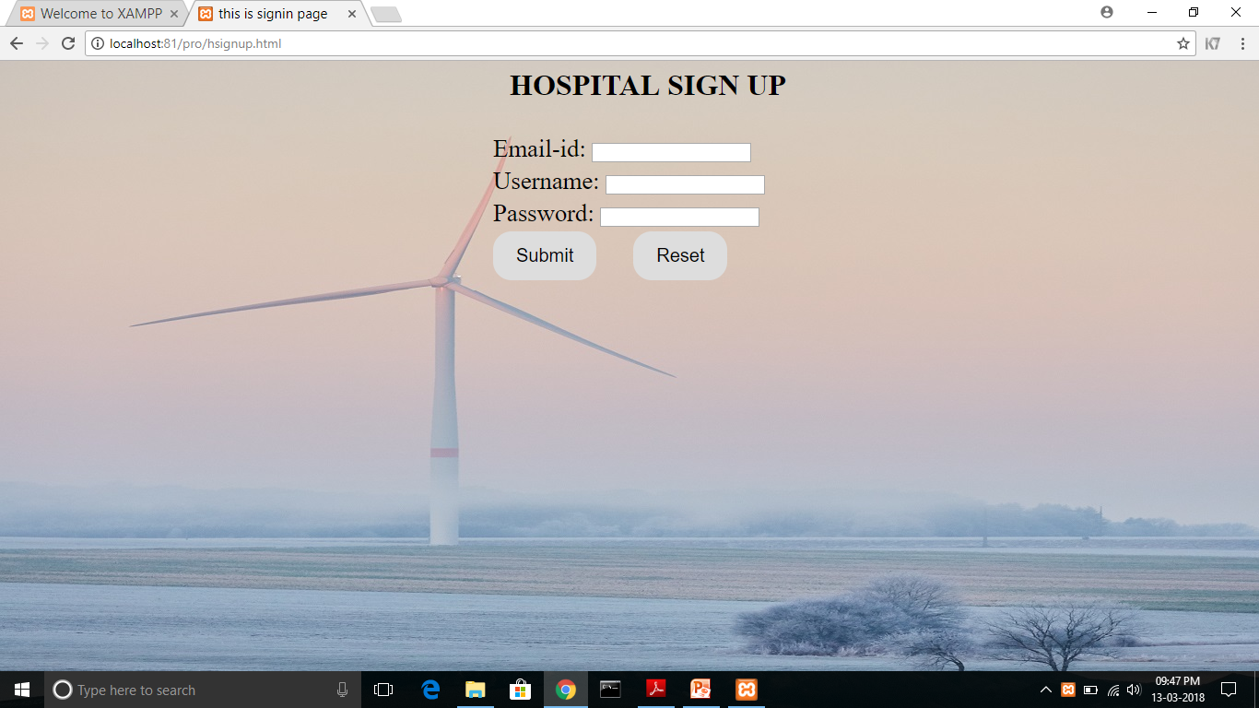
If the hospital management wants to register

Slide 33
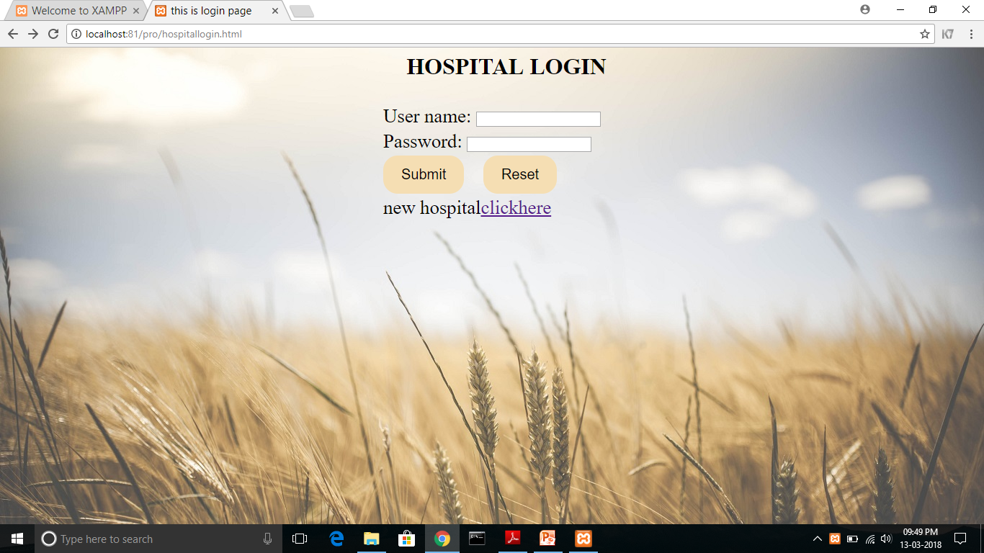
Hospital login page

Slide 34
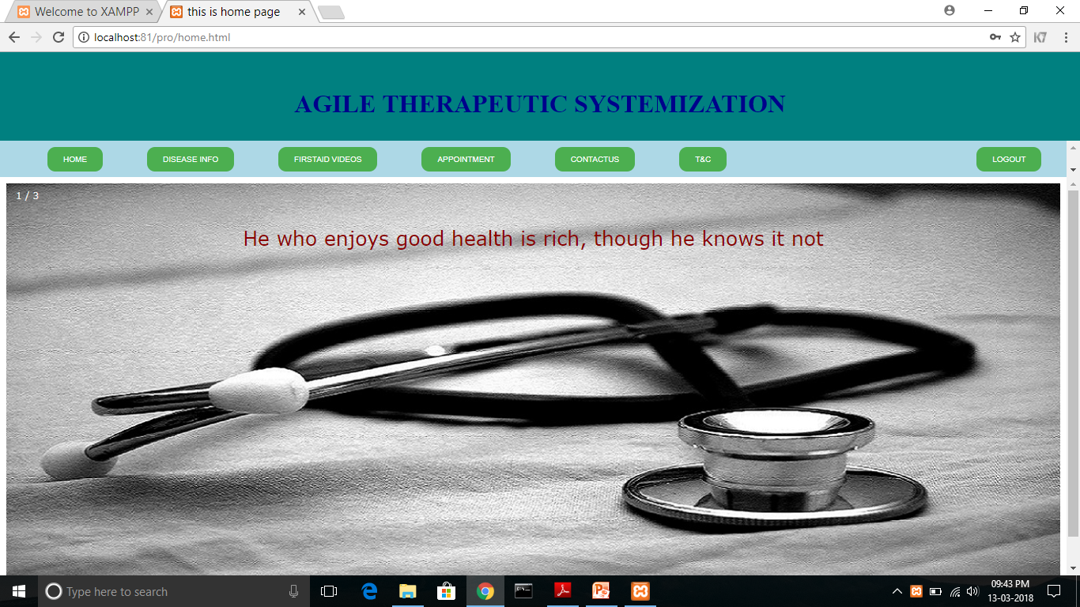
Homepage of Agile Therapeutic Systemization

Slide 35
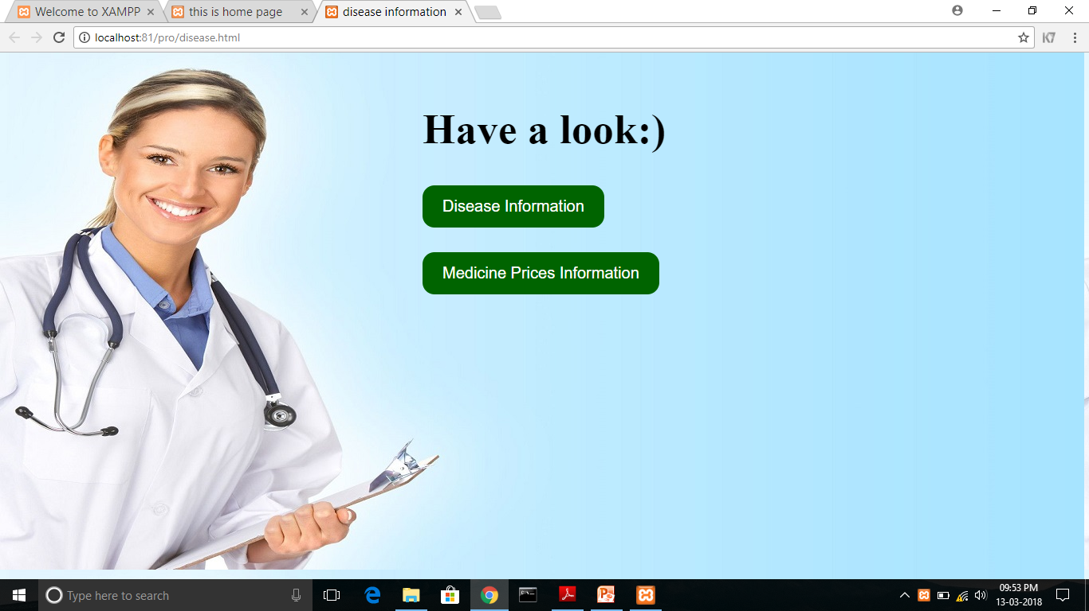
If user wants to view disease information

Slide 36
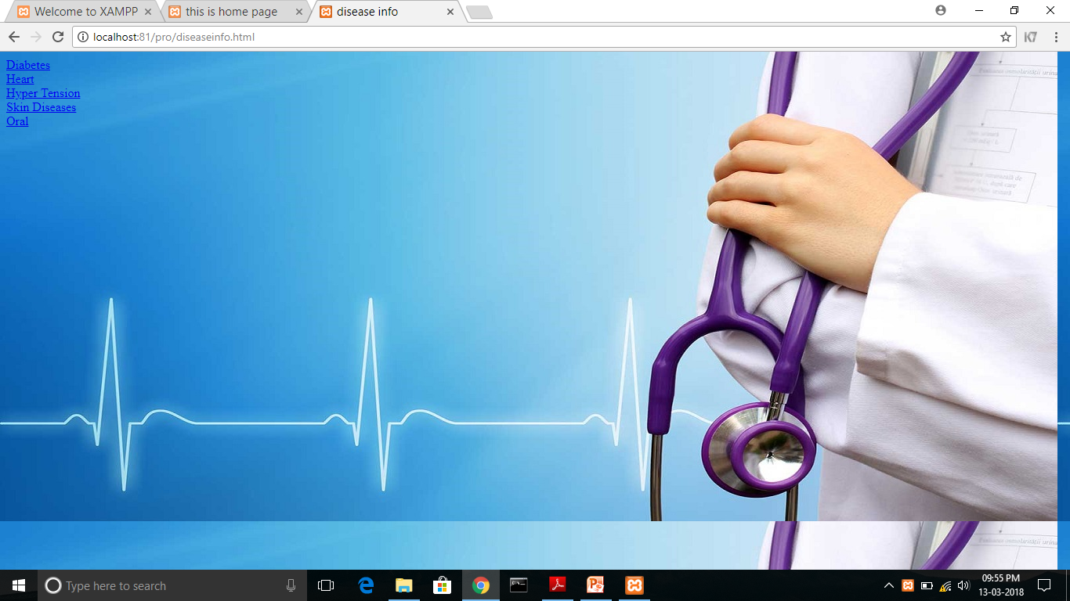
If user clicks disease information

Slide 37
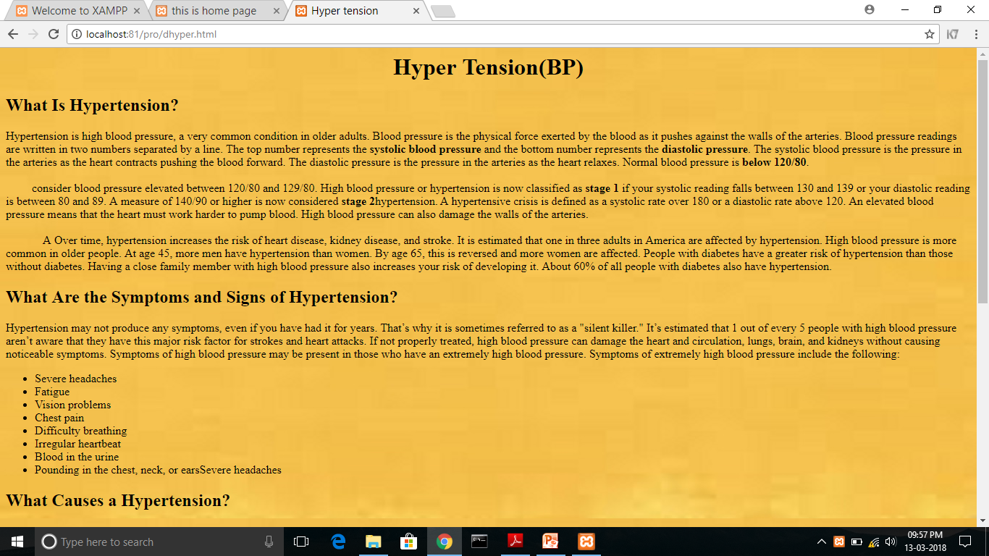
Viewing one of the disease information

Slide 38
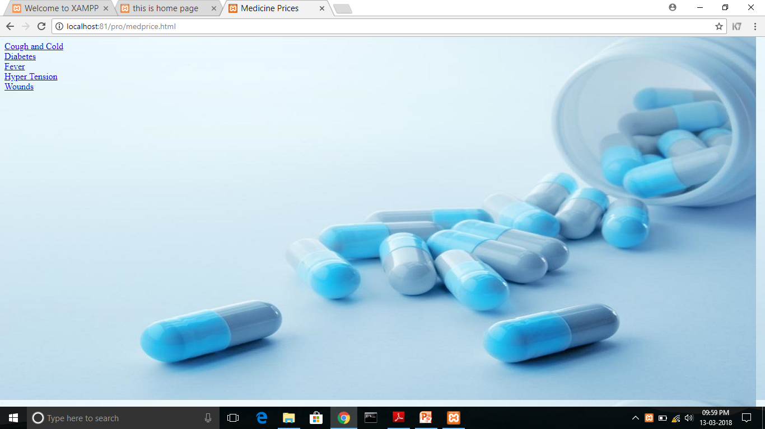
If user clicks medicine prices information

Slide 39
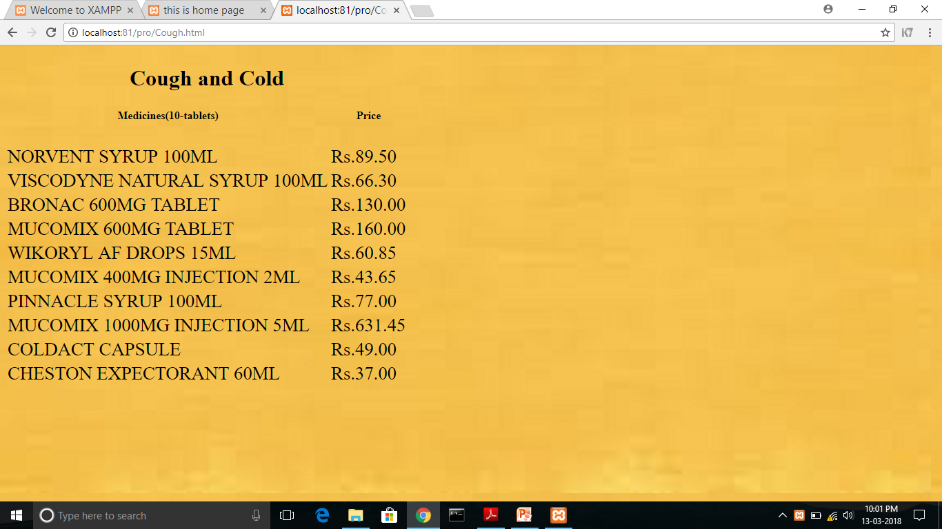
Viewing one of the medicine prices information

Slide 40
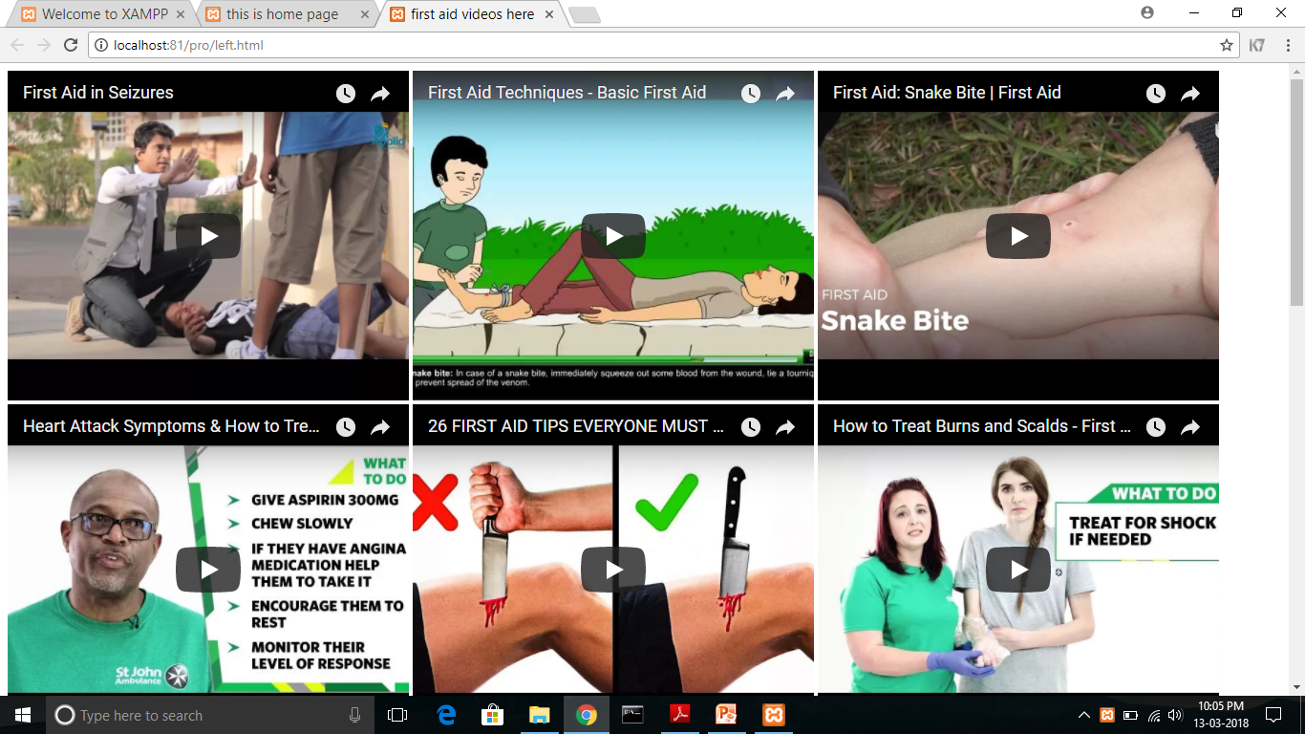
If user want to watch first-aid videos

Slide 41
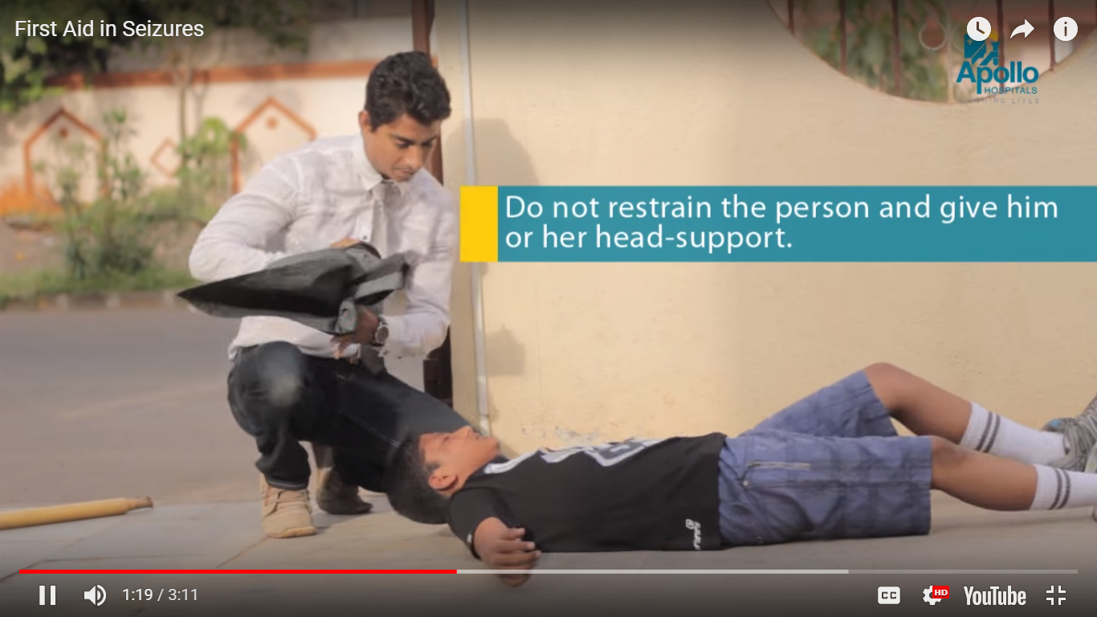
Playing a video

Slide 42
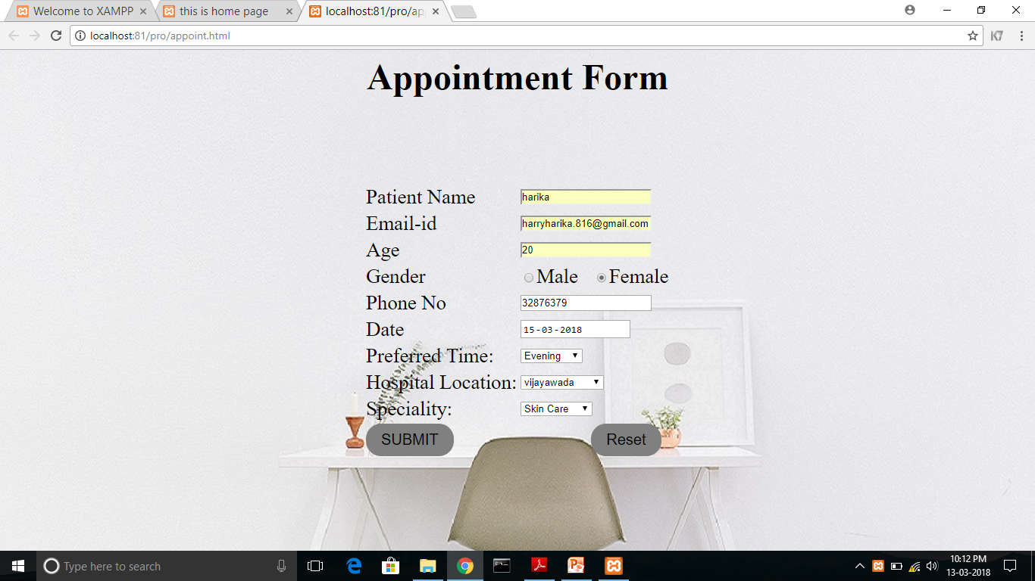
If the user want to made an appointment

Slide 43
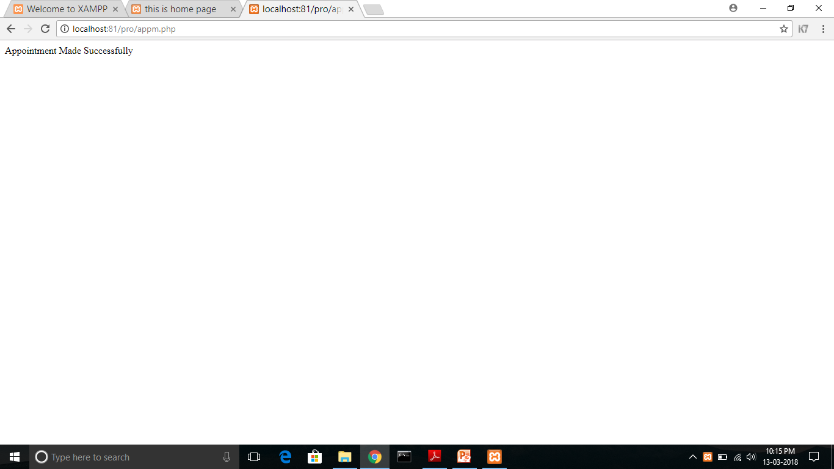
If the appointment was successful

Slide 44
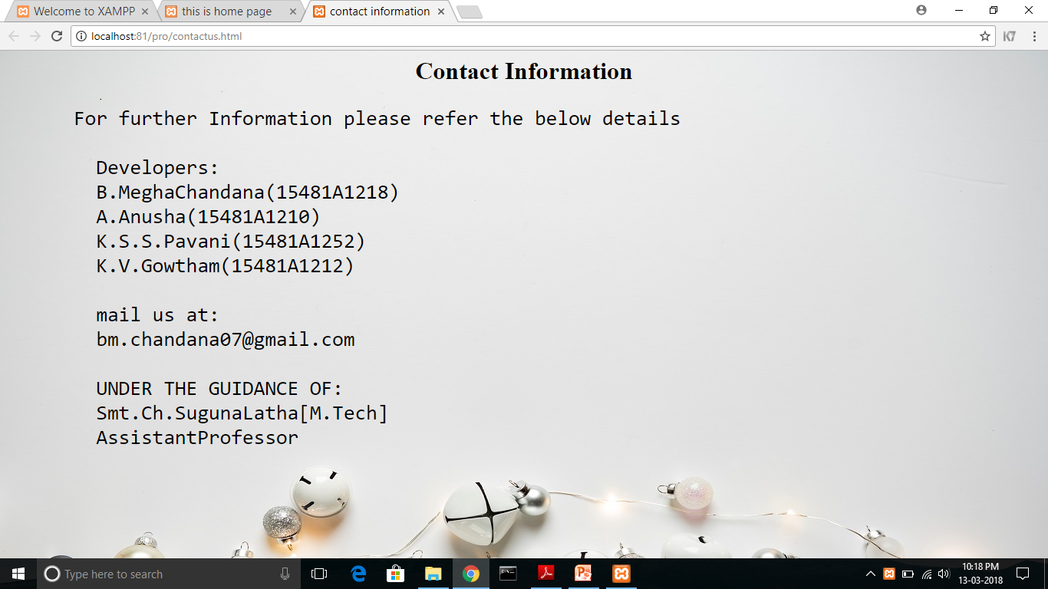
Displaying contact information

Slide 45
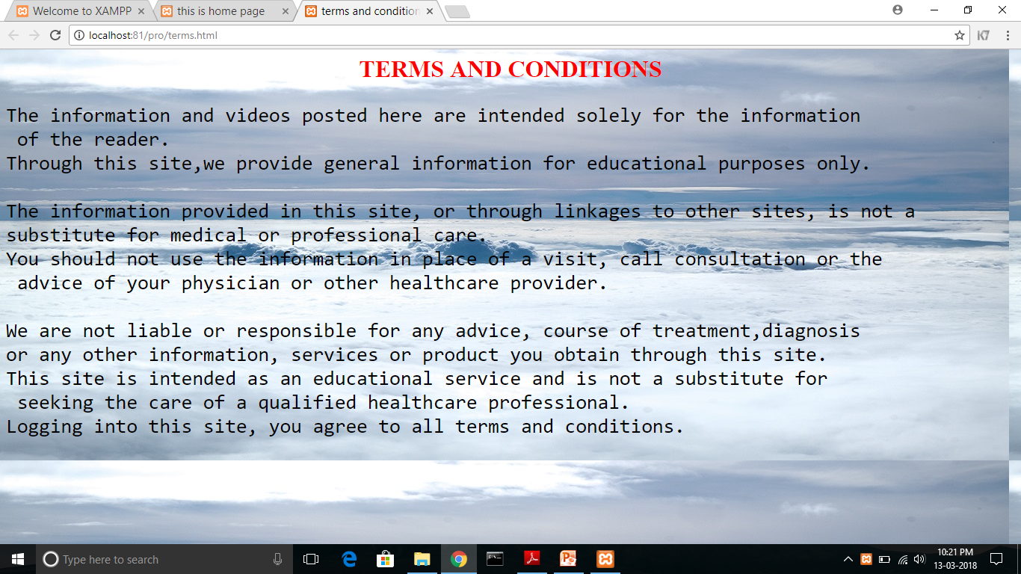
Displaying terms and conditions page

Slide 46
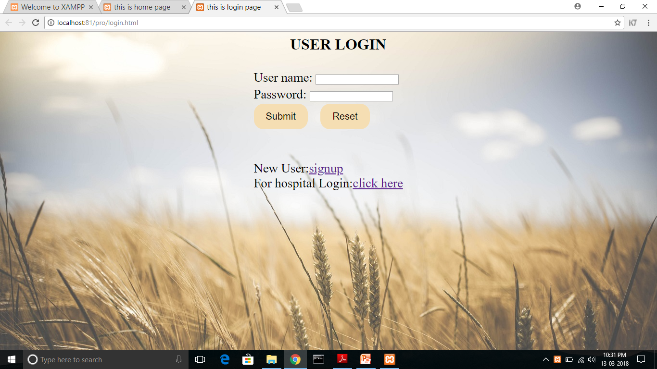
After logout it redirects to login page

Slide 47
